Slide 1
COSYNE 2018
Neuroinformatics recap

Slide 2
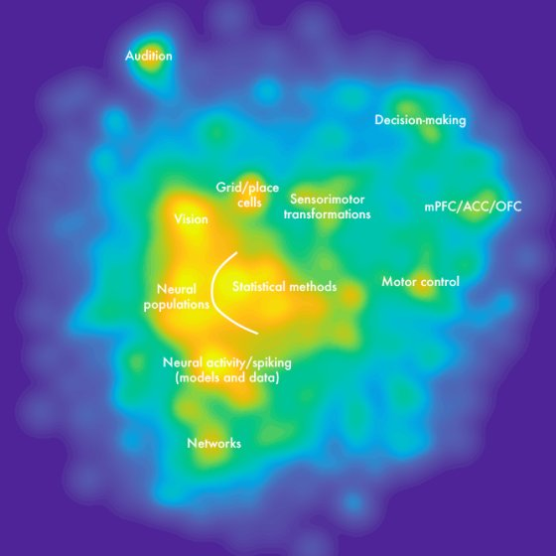
The COSYNE continent

Slide 3
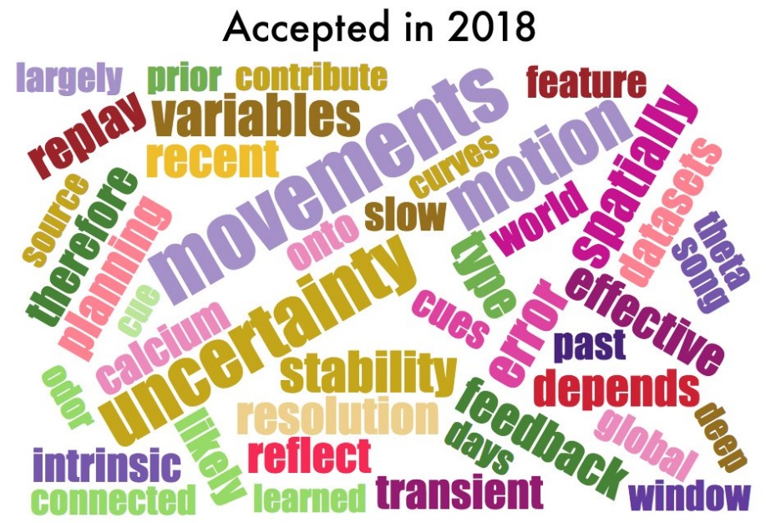
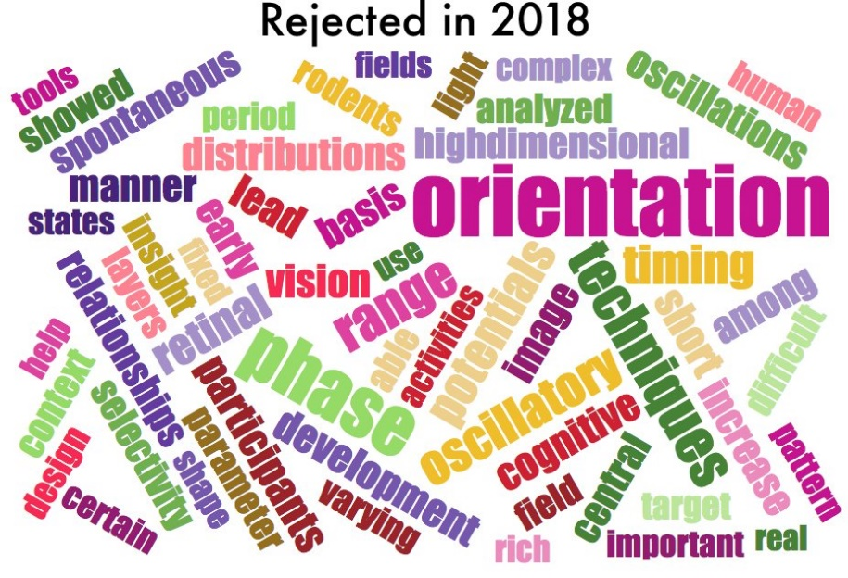
COSYNE 2018
#cosyne18

Slide 4
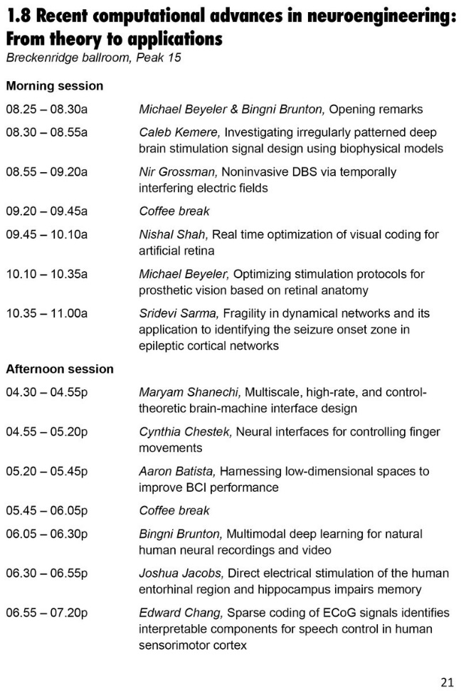
COSYNE 2018
Main meeting (Denver, CO)
Tutorials
Single-track talks
Poster sessions
Workshops (Breckenridge, CO)
Neuroengineering workshop

Slide 5

MANIFOLDS EVERYWHERE

Slide 6
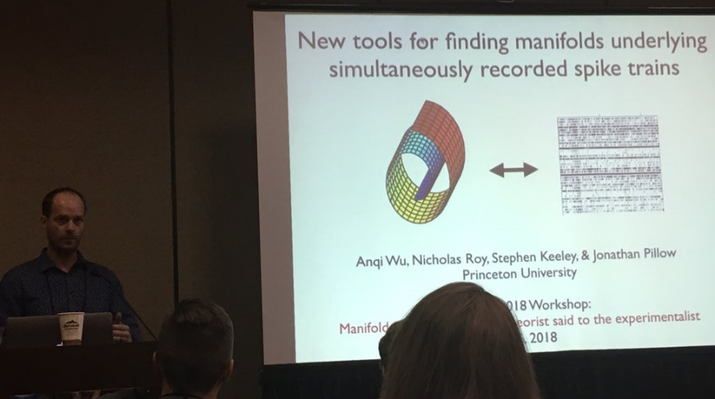
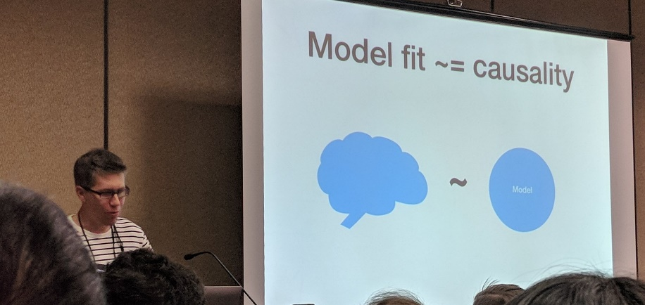
Manifoldsplaining
Manifolds: topological space that locally resembles Euclidean space near each point
Pillow:
Manifolds are not scary
Latent variable models have been verified in areas where we know what’s encoded
now to search for the latent variables in unknown areas
Kording:
ability to capture properties of the data doesn’t indicate (correct) causality

Slide 7
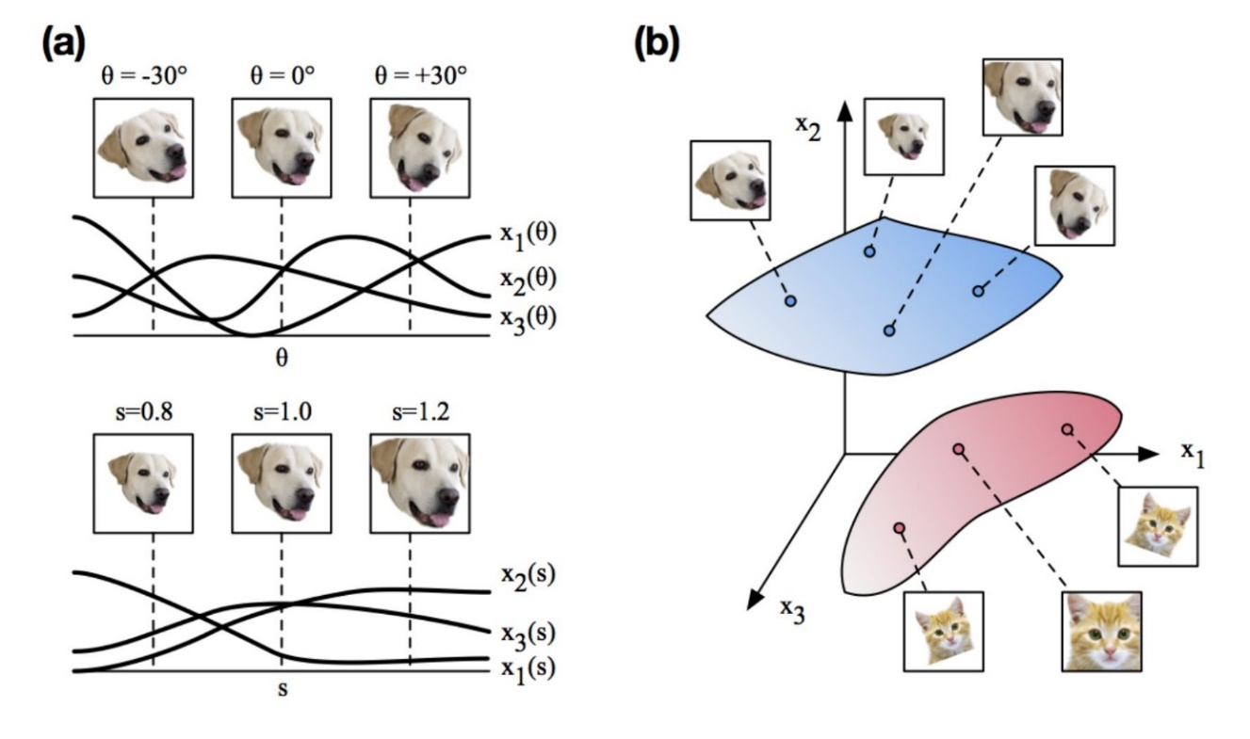
Manifolds in 10,000 visual cortex neurons
Stringer (HHMI Janelia)
Neural activity is as high-D as it can be while remaining on a smooth manifold (in mice)
possibly reflecting a fundamental optimal trade-off between discriminability (orthogonality) and generalization (smoothness) of representations
https://arxiv.org/pdf/1710.06487.pdf

Slide 8
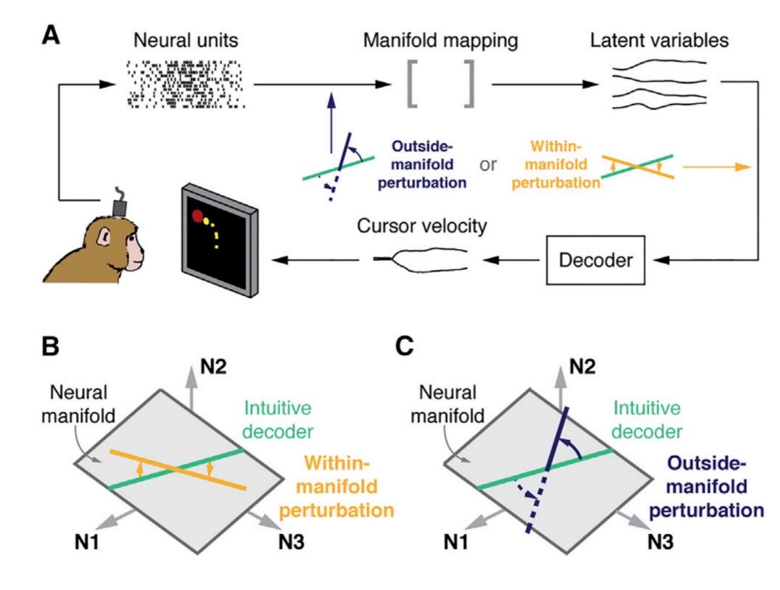
Manifolds in BCI
Yu (Carnegie Mellon)
BCI can be used to apply and study perturbations to networks to improve our basic science understanding of sensory-motor encoding
intrinsic low-dimensional manifold due to neuronal correlations
it’s easier for subjects to learn to control BCI when control system changes within manifold
Emily Oby: Given enough time, monkeys can learn outside-manifold perturbations
they do so by generating neural activity patterns outside the manifold

Slide 9
CODE & DATA

Slide 10
Brain Modeling Toolkit (BMTK)
Allen Institute for Brain Science
open-source software package for creating and simulating large-scale brain models (Python)
supports building, simulation and analysis of models of different levels of resolution including
biophysically detailed networks (NEURON)
point neuron networks (NEST)
population-level networks (DiPDE)
machine-learning networks
https://alleninstitute.github.io/bmtk

Slide 11
Intracranial EEG atlas
Frauscher et al. (McGill)
Multicenter study to provide an atlas of normal intracranial EEG of the human brain during wakefulness
1785 channels with normal brain activity from 106 subjects
registered to a common stereotaxic space
can be filtered, visualized and selected by brain region and electrode type
The atlas provides a normative baseline against which clinical EEGs can be compared, and is available as an open web resource
https://mni-open-ieegatlas.research.mcgill.ca

Slide 12
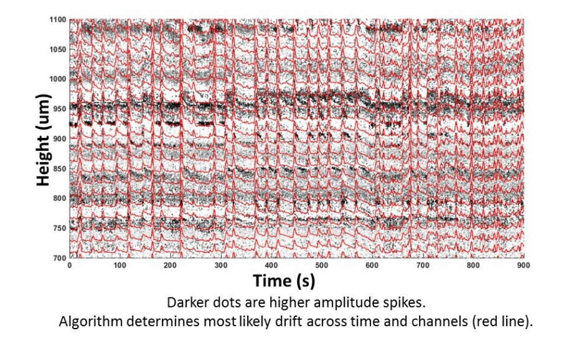
Drift correction for electrophysiology and two-photon calcium imaging
Pachitariu et al. (HHMI Janelia)
Vertical drift (Z-drift) is a major confound for neural recordings during behavior
brain floats in liquid
movement up to 20um typical
=> creates apparent change in the activity of recorded neurons
Method to discover and correct drift:
align to densely-scanned reference volume (z-stack)
estimate from a nonfunctional channel (e.g. tdTomato expressed in a neuronal subclass)
estimate from changes in the shape of identified cells in functional recordings
https://github.com/cortex-lab/Suite2P
https://github.com/cortex-lab/KiloSort

Slide 13
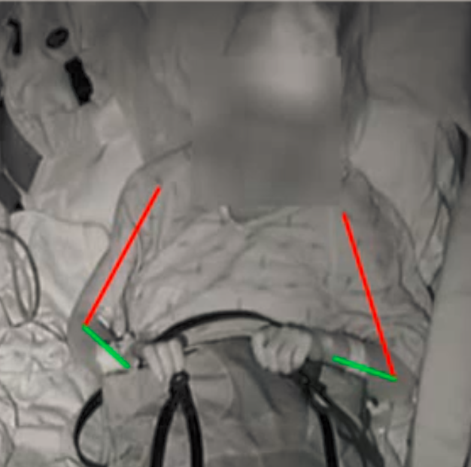
Annotated joints in long-term ECoG
Brunton (UW)
AJILE dataset
naturalistic long-term ECoG recordings with simultaneous upper body joint locations
4 subjects
each with ~ 1 week of continuous ECoG recording with 82-96 channels
60 million frames, 560 hours
https://www.bingbrunton.com/data

Slide 14
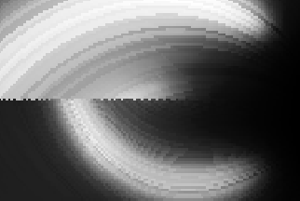

pulse2percept
BSD-licensed Python-based simulation framework for bionic vision
What’s it like to see the world with a bionic eye?
Code: https://github.com/uwescience/pulse2percept
Docs: https://uwescience.github.io/pulse2percept
$ pip install pulse2percept
implant
pulse2percept
percept
stimulus

Slide 15
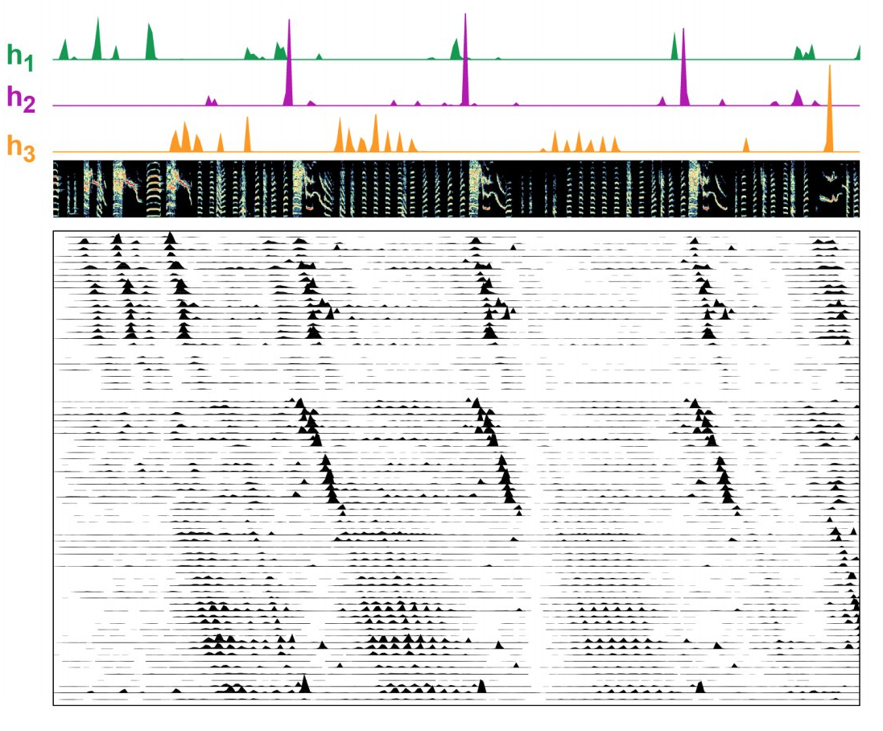
seqNMF
Mackevicius et al. (MIT)
Major challenge: to identify interpretable, low-dimensional features that capture the dynamics of large-scale neural recordings
PCA and NMF can’t capture dynamics that include repeated patterns
seqNMF: regularized convolutional NMF
regular NMF: each pattern represented by a single vector
convolutional NMF: exemplar pattern represented over brief period of time
regularization: penalize duplicated factors
https://doi.org/10.1101/273128
https://github.com/FeeLab/seqNMF

Slide 16
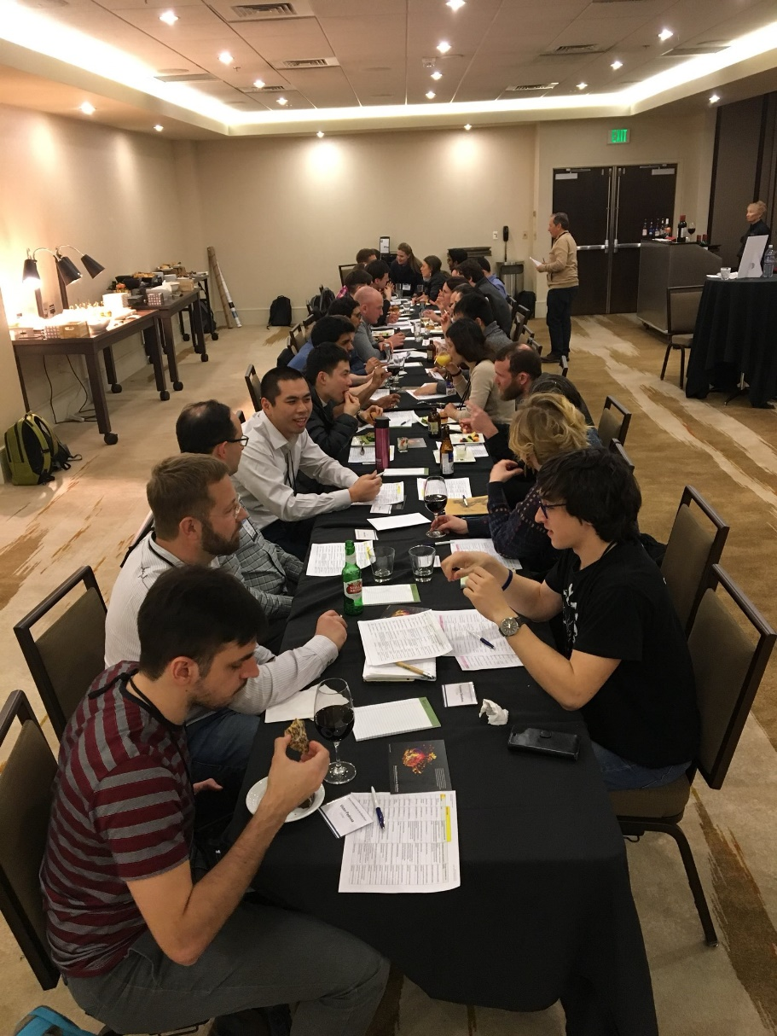
Experimental-theoretical matchmaking (aka speed dating)

Slide 17

LARGE-SCALE DATA ANALYSIS

Slide 18
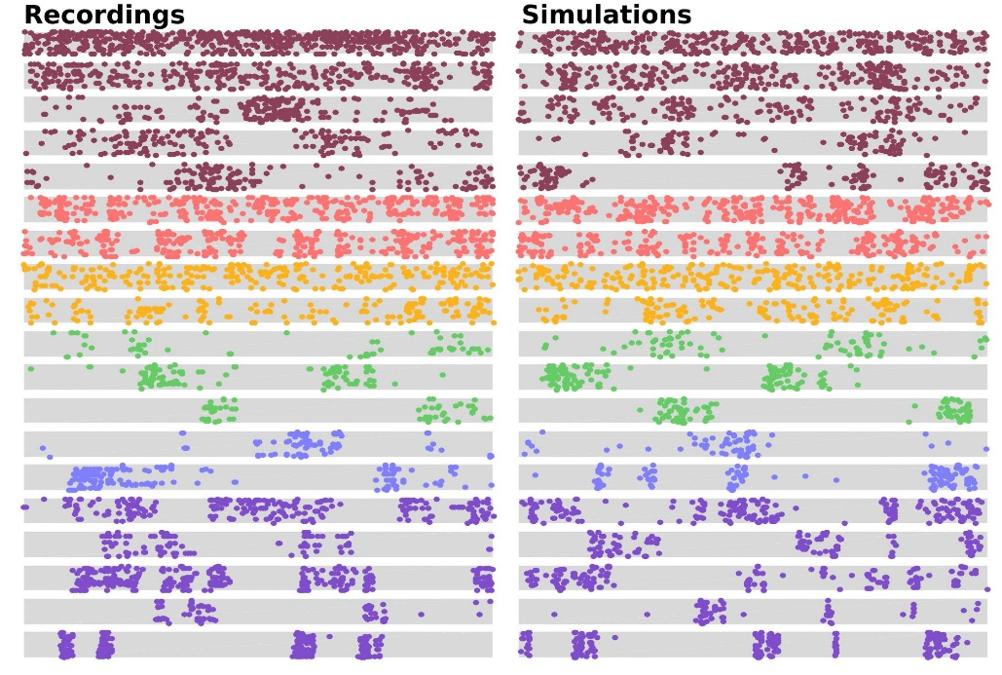
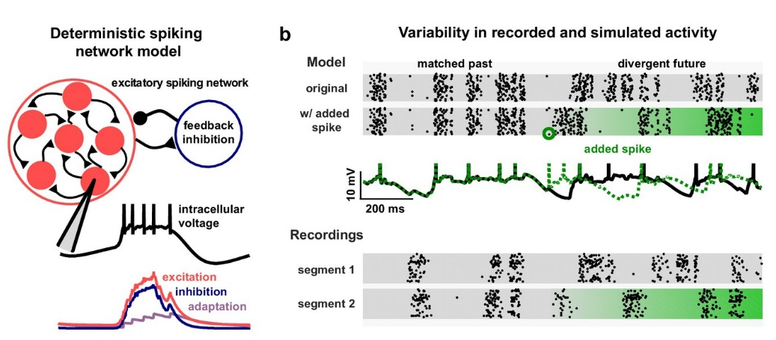
Inhibitory control of correlated intrinsic variability in cortical networks
Stringer (HHMI Janelia)
reproduced the zoo of cortical dynamics in 63 datasets using a single biophysical model
rats, mice, gerbils
different sensory modalities (V1, A1)
different behavioral states (awake, under one of several anesthetic agents)
spiking neural network
nonselective feedback inhibition
single-neuron adaptation currents
random connectivity (sparse)
inhibition matters the most

Slide 19
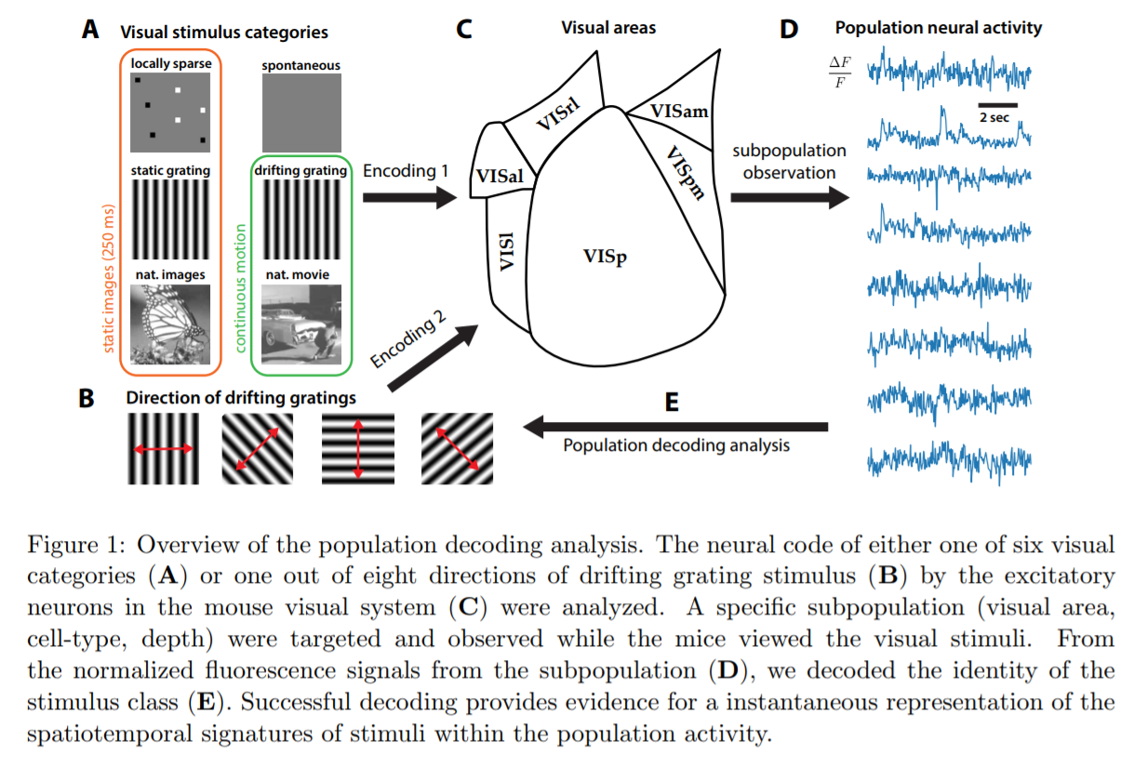
Organization of neural population code in mouse visual system
Esfahany et al. (Stony Brook)
Population decoding of Allen Brain Observatory visual cortex dataset
https://www.biorxiv.org/content/early/2017/12/04/220558

Slide 20


Slide 21

People got stuck in Denver ☹

Slide 22



Slide 23
DEEP LEARNING

Slide 24
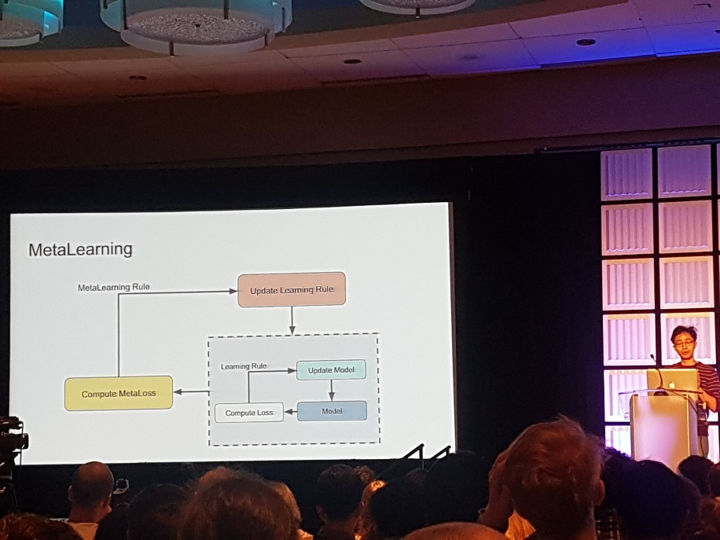
Supervised learning of unsupervised learning rules
Cheung
Unsupervised learning rules can be discovered as part of a meta learning procedure, with labeled data evaluating the success of the unsupervised learning rule
Outer loop used to learn a learning rule for the inner loop
no backprop needed
scales well to more layers/more units

Slide 25
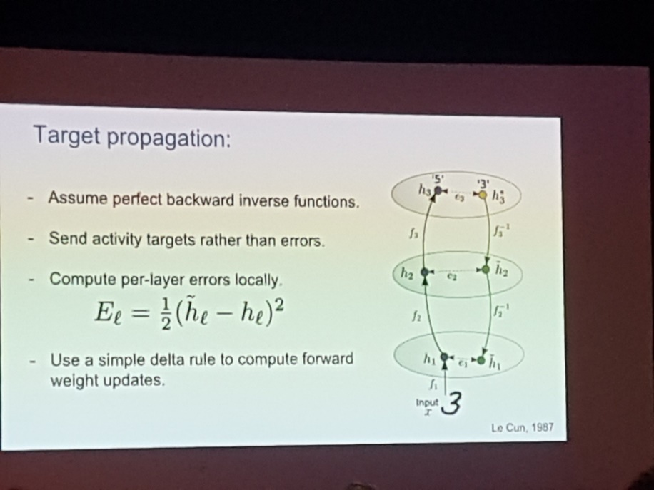
Assessing the scalability of biologically-motivated deep learning algorithms and architectures
Bartunov et al. (DeepMind)
not clear how the brain might implement backpropagation
biologically motivated model of deep learning:
target propagation just updates within-layer rates
difference target-propagation adds autoencoding each layer for backwards loss
CIFAR-10: competitive results
ImageNet: backprop better
different architectures needed to scale approach?

Slide 26
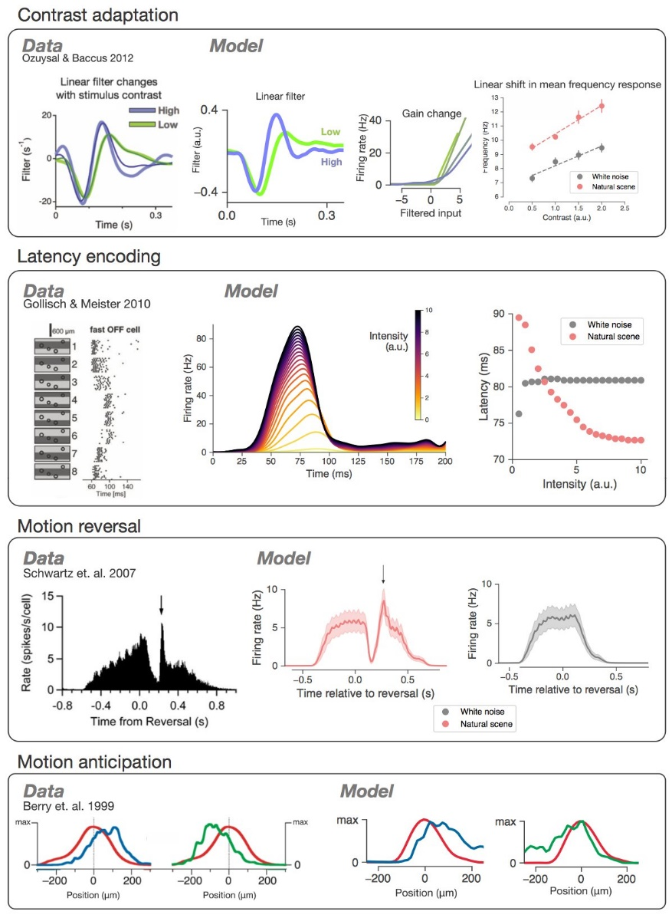
Deep Retina
Maheswaranathan et al. (Stanford)
Deep network trained to reproduce retinal responses to natural scenes also exhibit a whole host of previously published phenomena
same models trained on white noise don’t have these phenomena
Stimulus:
sequence of natural images
randomly selected every half a second
with additional jitter drawn according to the statistics of fixational eye movements
http://papers.nips.cc/paper/6388-deep-learning-models-of-the-retinal-response-to-natural-scenes
http://nirumaheswaranathan.com/research/deepretina_cosyne2018.pdf

Slide 27
The Consciousness Prior
Bengio (Montreal University)
Consciousness:
self-consciousness (awareness)
is about having a model of oneself (but sensation of that model is part of qualia)
attention
determines what is being perceived
subjective perception (qualia)
Consciousness prior: low dimensional hidden states used to control other high dimensional states
“integrated information”? “control of attention”?
consciousness prior is a misnomer?
Essentially no idea what he’s talking about

Slide 28
SECRET WINNER

Slide 29
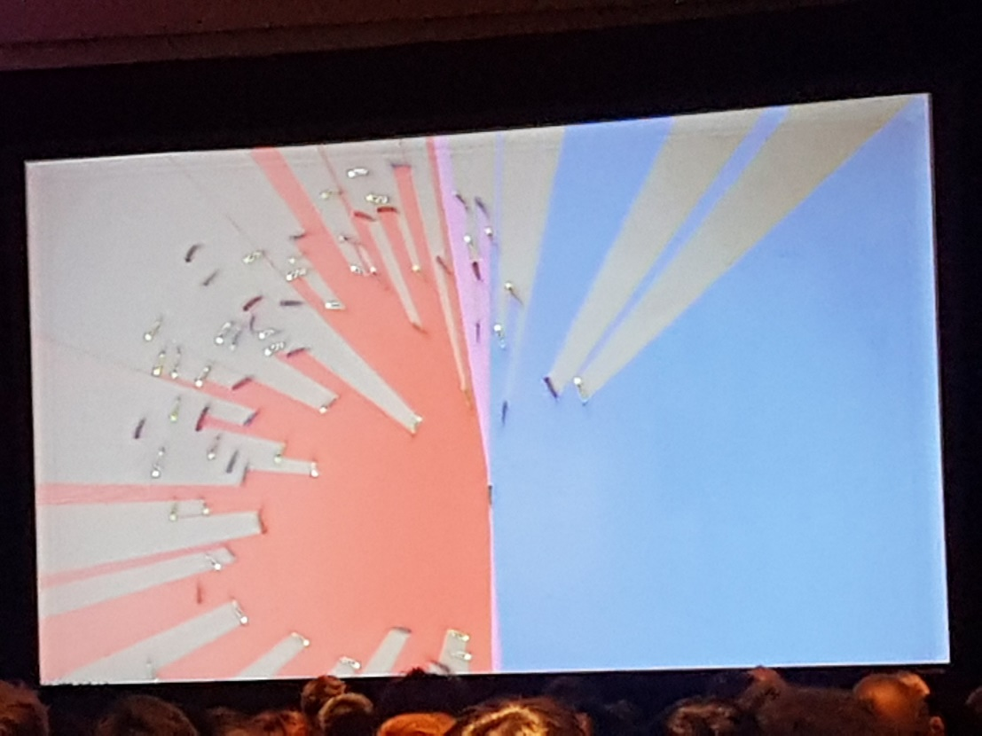
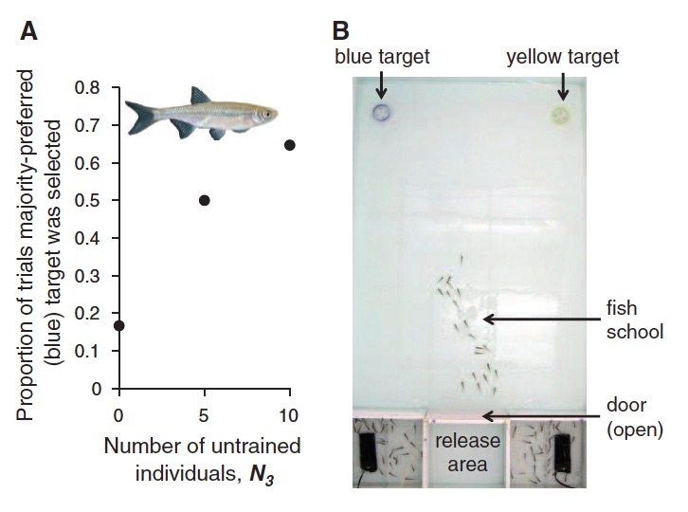
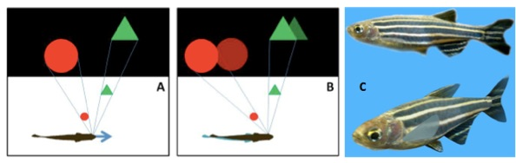
Collective sensing and decision-making
Iain Couzin (Konstanz University)
Group decisions in schooling fish
don’t require signaling, individual recognition or knowledge of the preferences of others
fish make decisions on neighbors and their distance
=> global optima can be found using only local decision rules
=> group has awareness whereas individuals do not
Most influential individuals not necessarily the most “popular” ones, but those who:
themselves have a low degree of connectivity
are connected to individuals with high degree of connectivity
Uninformed individuals are not just “noise”
prevent a strongly opinionated minority within a group from otherwise dominating the decision-making process, and return control to the numerical majority
http://www.pnas.org/content/pnas/112/15/4690.full.pdf

Slide 30
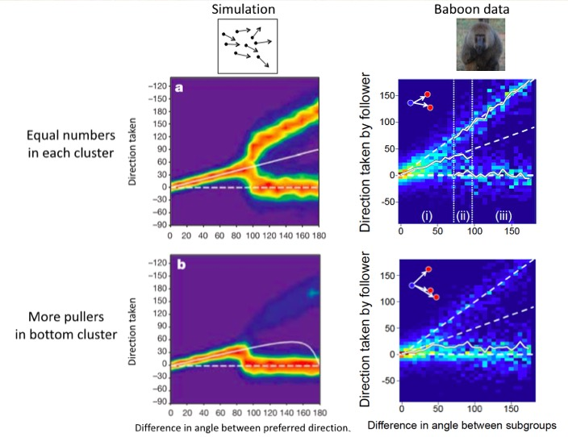

Consensus decision-making and ‘voting’ in groups
Iain Couzin (Konstanz University)
Do bigger groups make better decisions (“wisdom of the crowds”)?
in real world, decisions rarely based on single cue
most cues exhibit spatiotemporal correlation (animals closer together in space are more likely to have a similar viewpoint, etc.)
=> A finite, often small, group size tends to maximize decision-making accuracy
What about the geometry of decision-making?
if directional difference of available options small: average
if directional difference large: majority-preferred preference (locally)

